Slide 1



Deep Learning Design Patterns with Tensorflow 2.0
Computer Vision Workshop - Models by Design Version: Jan 2020
Repo: github.com/GoogleCloudPlatform/keras-idiomatic-programmer
twitter.com/andrewferlitsch

Slide 2
Model Design Patterns
History
Prior to 2017, the majority of renditions of neural network models were coded in a batch scripting style.
As AI researchers and experienced software engineers became increasingly participating in research and design, one started to see a shift in the coding of models that reflected software engineering principles for reuse and design patterns.

Slide 3
Model Design Patterns
Procedural Design Pattern
The early versions of using design patterns for neural network models was the use of a procedural style for reuse.
A design pattern implies that there is a “pattern” for constructing and coding a model which can be re-applied across a wide range of cases.
We will cover one procedural reuse design pattern based on the Idiomatic design pattern for convolutional neural network models.

Slide 4
Model Design Patterns
Idiomatic Procedural Design Pattern
The idiomatic design pattern views the model as consisting of:
an overall macro architecture pattern,
each macro component consisting of a micro architecture design.
For a convolutional neural network (CNN), follows the convention of consisting of three macro components:
a stem
a learner
a task

Slide 5
Macro Architecture
Learner
Conv Group
Conv Group
Conv
Group
Stem
Task
Pre-Stem Group
Stem Convolution Group
...
Task Group
Data Preprocessing
Task Learning
Feature Learning

Slide 6
Macro Architecture
Procedural Style Template (Idiomatic)
def stem(inputs): ''' stem layers inputs : the input tensors (e.g., images) ''' return outputs def learner(inputs): ''' leaner layers inputs : the input tensors (feature maps) ''' return outputs def task(inputs, n_classes): ''' classifier layers inputs : the input tensors (feature maps) n_classes : the number of output classes ''' return outputs
# Assemble the model inputs = Input(input_shape=(224, 224, 3)) x = stem(inputs) x = learner(x) outputs = task(x, n_classes=1000) model = Model(inputs, outputs)

Slide 7
Micro Architecture - Stem
Stem
The stem component is the entry point to the neural network.
It’s primary purpose is to perform the first (coarse level) feature extraction while reducing the feature maps to a size designed for the learner component;
whereby, the number of feature maps and corresponding size is optimized to maximize the feature extraction and minimize the number of parameters in the learner component.

Slide 8
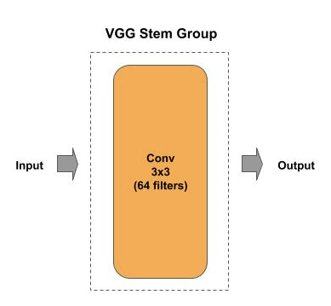
Micro Architecture - Stem
Example: VGG Stem Group
VGG was designed to take as an input a 224x224x3 image and output 64 feature maps, each of size 224x224. The VGG stem group did not do any size reduction of the feature maps.
def stem(inputs): """ Construct the Stem Convolutional Group inputs : the input tensor """ outputs = Conv2D(64, (3, 3), strides=(1, 1), padding="same", activation="relu")(inputs) return outputs

Slide 9
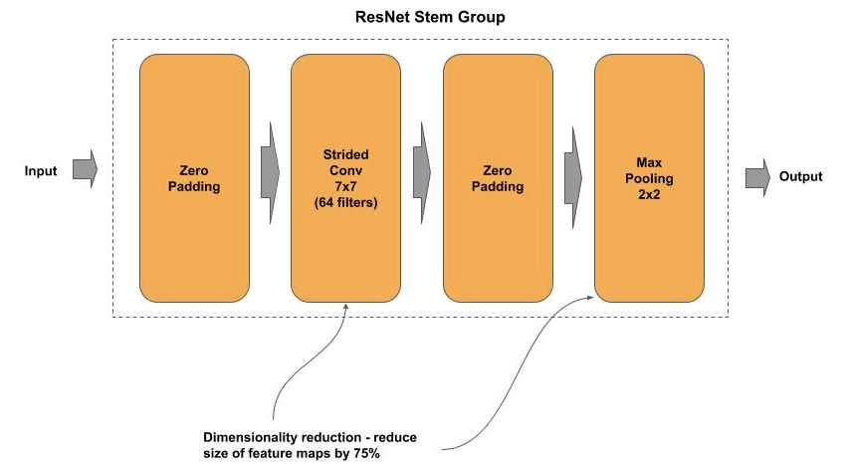
Micro Architecture - Stem
Example: ResNet Stem Group
ResNet stem group consists of one 7x7 convolutional layer for coarse feature extraction to obtain coarse features over a wider window: a 3x3 covers 9 pixels, while a 7x7 covers 49 pixels.
For feature map reduction, the ResNet stem group does both a feature pooling step and downsampling.

Slide 10
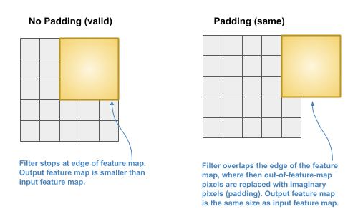
Micro Architecture - Stem
Example: ResNet Stem (no) Padding
The ResNet stem convolutional layer uses no padding when sliding the filter across the image. Thus, when the filter reaches the edge of the image it stops. Since each pixel does not have its own slide (the edges) by the filter, the output size is smaller than the input size. This is specified with the keyword parameter padding=’valid’ to the Conv2D layer.

Slide 11
Micro Architecture - Stem
Example: ResNet Stem Padding
One can slide the filter over the edge until the last row and column are covered. But, part of the filter would hang over imaginary pixels. There are several strategies on what could be padded as the imaginary pixels. The most common convention today is to pad the imaginary pixels with the same pixel value at the edge. This is specified with the keyword parameter padding=’same’ to the Conv2D layer.

Slide 12
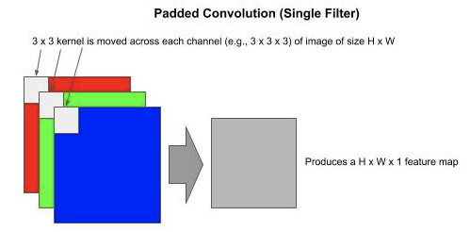
Micro Architecture - Stem
Padding - Single Filter
Below is a depicted of using a convolution with padding on an image of size H x W x 3 (three channels for RGB). With a single filter one would output a feature map of size H x W x 1.

Slide 13
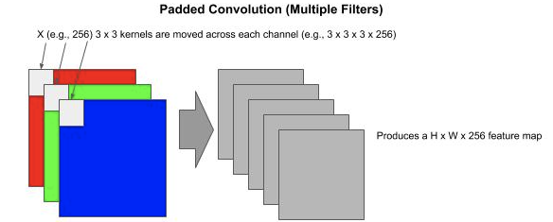
Micro Architecture - Stem
Example: Multi-Filter
With multiple filters C, one would output a feature map of size H x W x C

Slide 14
Micro Architecture - Stem
Example: ResNet Stem Group
ResNet predated this convention and padded the imaginary pixels with zero values; hence, why you see in the stem group the ZeroPadding2D layers, where a zero padding is placed around the image.
def stem(inputs): """ Construct the Stem Convolutional Group inputs : the input vector """ # The 224x224 images are zero padded (black - no signal) to be 230x230 images # prior to the first convolution outputs = ZeroPadding2D(padding=(3, 3))(inputs) # First Convolutional layer which uses a large (coarse) filter outputs = Conv2D(64, (7, 7), strides=(2, 2), padding='valid')(outputs) outputs = BatchNormalization()(outputs) outputs = ReLU()(outputs) # Pooled feature maps will be reduced by 75% outputs = ZeroPadding2D(padding=(1, 1))(outputs) outputs = MaxPooling2D((3, 3), strides=(2, 2))(outputs) return outputs

Slide 15
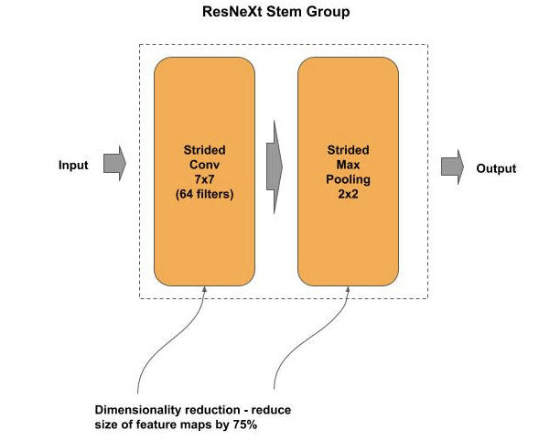
Micro Architecture - Stem
Example: ResNeXt Stem Group
Subsequent models to ResNet used the convention of same padding, which reduces the layers to a single strided convolution (feature pooling) and strided max pooling (downsampling), while maintaining the same computational complexity. Below is the stem group for a ResNeXt model by Facebook AI, which introduced the concept, along with Inception by Google AI, of wide residual blocks.
def stem(inputs): """ Construct the Stem Convolution Group inputs : input vector """ outputs = Conv2D(64, (7, 7), strides=(2, 2), padding='same')(inputs) outputs = BatchNormalization()(outputs) outputs = ReLU()(outputs) outputs = MaxPooling2D((3, 3), strides=(2, 2), padding='same')(outputs) return outputs

Slide 16
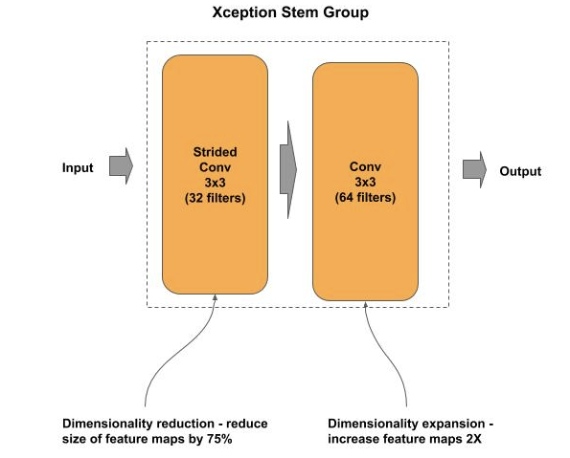
Micro Architecture - Stem
Example: Xception Stem Group
Subsequent state-of-the-art (SOTA) models, the 7x7 filter size was replaced with a smaller 5x5 filter, which had lower computational complexity. The common convention today, is the 5x5 filter is refactored into two 3x3 filters, which have the same representational power (equivalence) with lower computational complexity.
def stem(inputs): """ Create the stem entry into the neural network inputs : input tensor to neural network """ # Strided convolution - dimensionality reduction # Reduce feature maps by 75% outputs = Conv2D(32, (3, 3), strides=(2, 2))(inputs) outputs = BatchNormalization()(outputs) outputs = ReLU()(outputs) # Convolution - dimensionality expansion # Double the number of filters outputs = Conv2D(64, (3, 3), strides=(1, 1))(outputs) outputs = BatchNormalization()(outputs) outputs = ReLU()(outputs) return outputs

Slide 17
Micro Architecture - Stem
Pre-Stems
With TF 2.0 see an emergence of adding a pre-stem group to the stem component.
The purpose of a pre-stem is to move into the graph (model) some or all of the data preprocessing that was performed upstream.
Prior to this, the data preprocessing was done in a separate module and had to be replicated when the model was deployed for inference (predicting on future examples). Generally, this was done on a CPU.
Many of the data preprocessing steps can be replaced by graph operations and more efficiently executed on a GPU, which typically is where the model is deployed on.

Slide 18
Micro Architecture - Stem
Pre-Stems - Plug n Play
Pre-stems are also plug-and-play in that they can be added or removed from existing models and reused.
Summary of functions typically performed by a pre-stem group:
Resizing and cropping.
Adapting a model to a different input size.
Normalization.
Translation and scale invariance.

Slide 19
Micro Architecture - Stem
Pre-Stems - Plug n Play
Coding sample of adding a pre-stem group to an existing [trained] model:
def prestem(input_shape): ''' pre-stem layers ''' return outputs # Create a wrapper model wrapper_model = Sequential() # Start the wrapper model with the pre-stem wrapper_model.add(prestem(input_shape=(224, 224, 3)) # Add the existing model to the wrapper model wrapper_model.add(model)

Slide 20
Micro Architecture - Learner
Learner
The learner component is where we generally perform “feature learning” and “feature extraction”.
The learner component consists of:
one or more convolutional groups,
where each group consists of one or more convolutional blocks.
One assemblies convolution blocks into groups based on a common model configuration attribute. The most common attributes for convolutional groups in conventional CNNs are:
the number of input or output filters
the size of the input or output feature maps.
:

Slide 21
Micro Architecture - Learner
Learner - Skeleton Template
def learner(inputs, groups): ''' leaner layers inputs : the input tensors (feature maps) groups : the block parameters for each group ''' outputs = inputs for group_parmas in groups: outputs = group(**group_params) return outputs def group(inputs, **blocks): ''' group layers inputs : the input tensors (feature maps) blocks : the block parameters for each block ''' outputs = inputs for block_parmas in blocks: outputs = block(**block_params) return outputs
def block(inputs, **params): ''' block layers inputs : the input tensors (feature maps) params : the block parameters for the block ''' return outputs # Assemble the learner component. # First group: two blocks of 128 filters # Second group: one block of 256 filters x = learner(x, [ [ {'n_filters: 128'}, {'n_filters: 128'} ], [ {'n_filters: 256'} ] ]

Slide 22
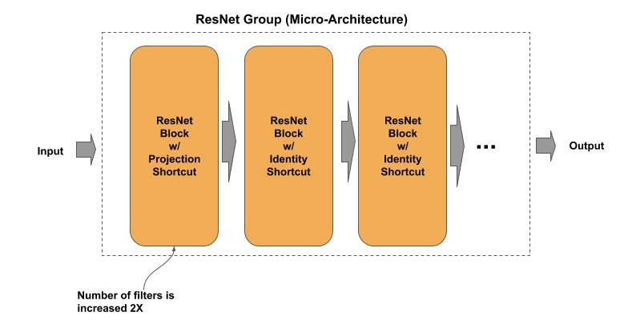
Micro Architecture - Learner
Learner - ResNet
Each ResNet group starts with a residual block with linear projection shortcut, and then followed by one or more residual blocks with identity shortcut. All the residual blocks in a group have the same number of output filters.
Each group successively doubles the number of output filters, and the residual block with linear projection shortcut doubles the number of filters from the input to the group. The output filters for the four groups in a ResNet50 are 64, 128, 256 and 512 respectively.

Slide 23
Micro Architecture - Learner
Learner - ResNet
def learner(inputs, groups): """ Construct the Learner inputs: input to the learner groups: group parameters per group """ outputs = inputs # First Residual Block Group (not strided) group_params = groups.pop(0) outputs = group(outputs, **group_params, strides=(1, 1)) # Remaining Residual Block Groups (strided) for group_params in groups: outputs = group(outputs, **group_params, strides=(2, 2)) return outputs
def group(inputs, blocks, strides=(2, 2)): """ Construct a Residual Group inputs : input into the group blocks : block parameters for each block strides : whether the projection block is a strided convolution """ outputs = inputs # Double the size of filters to fit the first Residual Group block_params = blocks.pop(0) outputs = projection_block(outputs, strides=strides, **block_params) # Identity residual blocks for block_params in blocks: outputs = identity_block(outputs, **block_params) return outputs

Slide 24
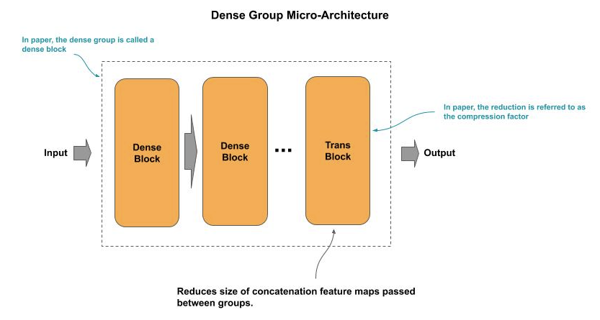
Micro Architecture - Learner
Learner - DenseNet
A DenseNet convolutional groups consist of two types of convolutional blocks. The first blocks are a DenseNet blocks for feature learning, and the last block is a transitional block for reducing the size of the feature maps prior to the next group, which is referred to as the compression factor. The last convolutional group has no transitional block.

Slide 25
Micro Architecture - Learner
Learner - Densely Connected
A DenseNet block is essentially a residual block, except that in place of adding (matrix add) the identity link to the output, it is concatenated.
In a ResNet, the information from previous inputs is only passed one block forward. Using concatenation, the information from the feature maps accumulates and each block passes all the accumulative information forward to all subsequent blocks.
The concatenation of feature maps would result in an continued growth in size of feature maps and corresponding parameters as we go deeper in layers.
To control (reduce) the growth, the transitional block at the end of each convolutional block compresses (reduces) the size of the concatenated feature maps.

Slide 26
Micro Architecture - Learner
Learner - DenseNet
def learner(inputs, groups, reduction): """ Construct the Learner inputs : input to the learner groups : set of number of blocks per group reduction : the amount to reduce (compress) by """ outputs = inputs # pop off the list the last dense block last = groups.pop() # Dense groups with interceding transition blocks for group_params in groups: outputs = group(outputs, reduction, **group_params) # Last dense group w/o a following transition block outputs = group(outputs, last, reduction=None) return outputs
def group(inputs, reduction=None, **blocks): """ Construct a Dense Group inputs : input tensor to the group reduction : amount to reduce feature maps by blocks : parameters for each dense block in the group """ outputs = inputs # Construct a group of densely connected residual blocks for block_params in blocks: outputs = residual_block(outputs, **block_params) # Construct interceding transition block if reduction is not None: outputs = trans_block(outputs, reduction) return outputs

Slide 27
Micro Architecture - Task
Task
The task component is where we generally perform “task learning” (e.g., classification learning).
The output from the learner component is a final reduced size of feature maps (e.g., 4x4 pixels). For example, for a ResNet50 the number of feature maps is 2048.
The task component in large conventional CNNs classifier typically consist of two layers.

Slide 28
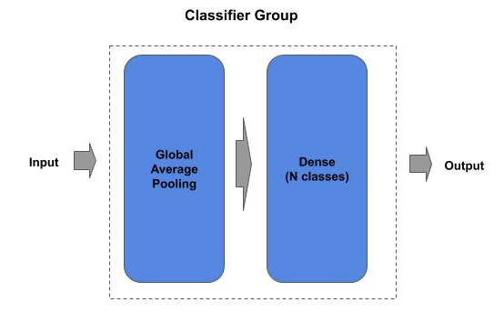
Micro Architecture - Classifier
Classifier
The first layer in the classifier component is both flattening the feature maps into a 1D vector and reducing the size, such as with GlobalAveragePooling2D. This flattening/reduction layer is also referred to as the bottleneck layer in a CNN model.
Following the bottleneck layer is a Dense layer that does the classification.

Slide 29
Micro Architecture - Classifier
Classifier - Basic (Standard)
def task(inputs, n_classes): """ The output classifier inputs : input tensor to the classifier n_classes : number of output classes """ # Global Average Pooling will flatten the feature maps into 1D feature vector outputs = GlobalAveragePooling2D()(inputs) # Fully connected output layer (classification) outputs = Dense(n_classes, activation='softmax')(outputs) return outputs

Slide 30
Micro Architecture - Classifier
Classifier - Multi-Output
In earlier deployed ML production systems, models were treated as independent algorithms and in these systems one was only interested in the final output (i.e.., prediction).
Today, we build not models, but applications that are an amalgamation (composition) of models. As a result, we no longer treat the classifier as a single output, but instead as having four outputs, depending on how the model is connected to other models in the application. This outputs are:
Feature Extraction
High Dimensionality (Encoding)
Low Dimensionality (Embedding) - Feature Vector
Prediction
Pre-activation (probabilities) - Soft Labels
Post-activation (outputs) - Hard Labels

Slide 31
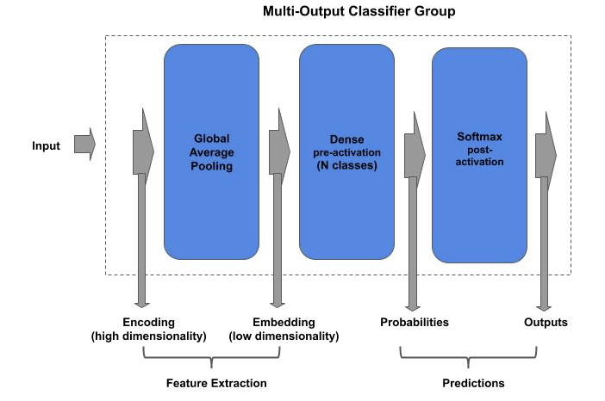
Micro Architecture - Classifier

Slide 32
Micro Architecture - Classifier
Classifier - Multi-Output
def task(inputs, n_classes): # high-dimensionality feature extraction encoding = inputs # Global Average Pooling will flatten the feature maps into 1D feature vector outputs = GlobalAveragePooling2D()(inputs) # low-dimensionality feature extraction embeddings = outputs # Fully connected output layer (classification) outputs = Dense(n_classes)(outputs) # pre-activation probabilities probabilities = outputs # post-activation probabilities outputs = Activation('softmax')(outputs) return encoding, embeddings, probabilities, outputs

Slide 33
Micro Architecture - Classifier
Classifier - Mobile/Compact
In compact models, particularly for mobile devices, the GlobalAveraging2D followed by a Dense layer is replaced with:
Conv2D using a softmax activation, where the number of filters is set to the number of classes
followed by a GlobalAveraging2D for the flattening into number of classes.

Slide 34
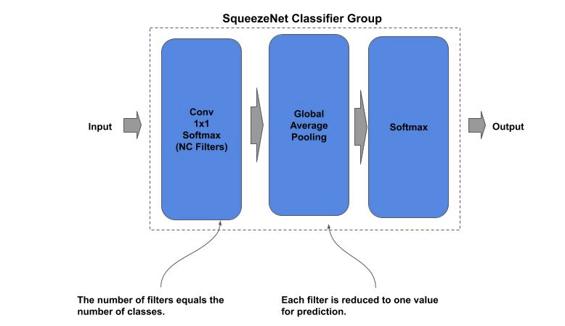
Micro Architecture - Classifier
Example: SqueezeNet Classifier
def task(inputs, n_classes): ''' Construct the Classifier inputs : input tensor to the classifier n_classes: number of output classes ''' # set the number of filters equal to number of classes outputs = Conv2D(n_classes, (1, 1), strides=1, activation='relu', padding='same')(inputs) # reduce each filter (class) to a single value outputs = GlobalAveragePooling2D()(outputs) outputs = Activation('softmax')(outputs) return x

Slide 35
Model Design Patterns - Lab Exercise #5
Optional Code Lab - Get Familiar with Model Design Patterns
Deep Learning Design Patterns - Workshop - Chapter 1.ipynb
https://bit.ly/2V8PjPt

